Slide 1

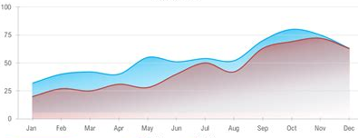
Techniques | Capabilities | Deliverables | Approach | Contact
achieve breakthrough results
Revenue & Margin Optimizations
platform solutions to scale margin and maximize revenue velocity
Companies | Business Lines | Programs | New Ventures | Whole Markets
{want a graph underneath the main Hero text like this but want to show cost going down (the red area) and revenue going up (green area). Would like it to be more pronounced like a big improvement in both has occurred (start towards middle point of hero of text)}

Slide 2
Techniques | Implementations-as-a-Service
Blended Strategy, Execution & Technical Services Expertise
Aimed at Delivering Needle Moving Outcomes
Market Expansions
Service Evolutions
Procedural Compliances
Automated Operations
Billing Velocity
Market Share Captures
Functional Adjacencies
Customer Integrations
Channel Models
Scales/Diversifications

Slide 3
Capabilities | Optimizations-as-a-Service {OFF State}
Zero-Trust
Controls
Process
Transformations
Event-Rule
Models
Dynamic
Configurations
Accountable
Permissions/Procedures
Compliance
Enforcements
Streamlinings
User Proofings
Functional
Automations
Nuanced
Workflows
Customer
Integrations
Loss Preventions
Expectation
Innovations
Systems
Integrations
KPIs/Analytics/Reports

Slide 4
Capabilities | Optimizations-as-a-Service {On State}
Zero-Trust
Controls
Verify every request, every time — no implicit access.
Process
Transformations
Rewrite the operating model, not just the software.
Event-Rule
Models
Declarative rules that react to operational events.
Dynamic
Configurations
Change operating parameters live — no deployment cycle.
Accountable
Permissions/Procedures
Every action attributable, every procedure auditable.
Compliance
Enforcements
Turn policy into enforced behavior, not just a binder.
Streamlinings
Compress steps, remove hand-offs, shorten time-to-done.
User Proofings
Guardrails that keep frontline users on the rails.
Functional
Automations
The manual work you keep doing — done by the platform.
Adaptive
Workflows
Branch logic, edge cases, and human context — handled.
Customer
Integrations
Customer-facing APIs, portals, and self-service flows.
Loss Preventions
Close leakage points before they compound.
Expectation
Innovations
Redefine customer realities to redirect spend to what actually produces.
Systems
Integrations
Bridge the legacy stack without the rip-and-replace.
KPIs/Analytics/Reports
The numbers that matter, surfaced where decisions happen.

Slide 5


Slide 6
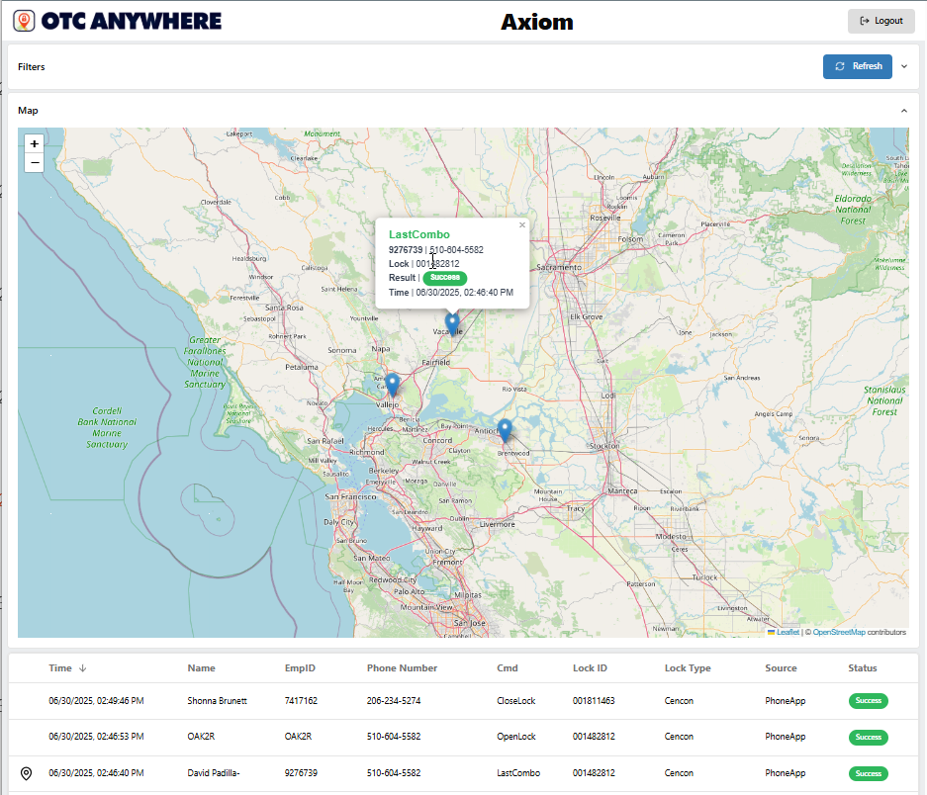


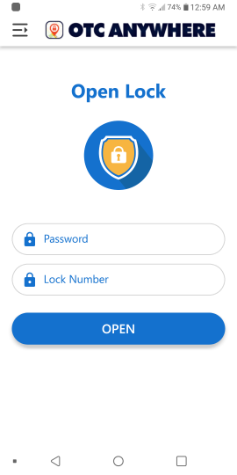
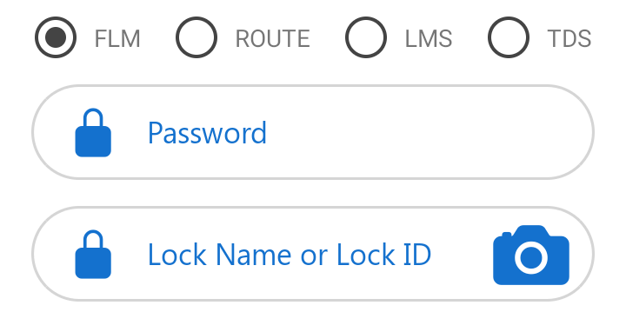


Breakthroughs Delivered
Market Optimization - ATM Access Management
Go ->
Secured ATM Lock Access Automation
Multiple ATM Lock Platforms (Dorma Kaba, S&G, Intergard)
500K+/mo Secured ATM Opens/Closes
Challenge:
Reduce manpower requirements to staff dispatch support operations while preserving fully lock access security and auditability
Target:
Securely automate permitted ATM lock access requests directly from authorized field technicians and cash loaders against multiple industry lock systems
Outcome:
Offloading 95%+ of routine daily manual dispatching costs
Secured Self Dispatch
Schedule Demo

Slide 7
Secured Self Dispatch
{Source Image at Folder | CoorWorks Website v3 | OTC.jpg}

Slide 8
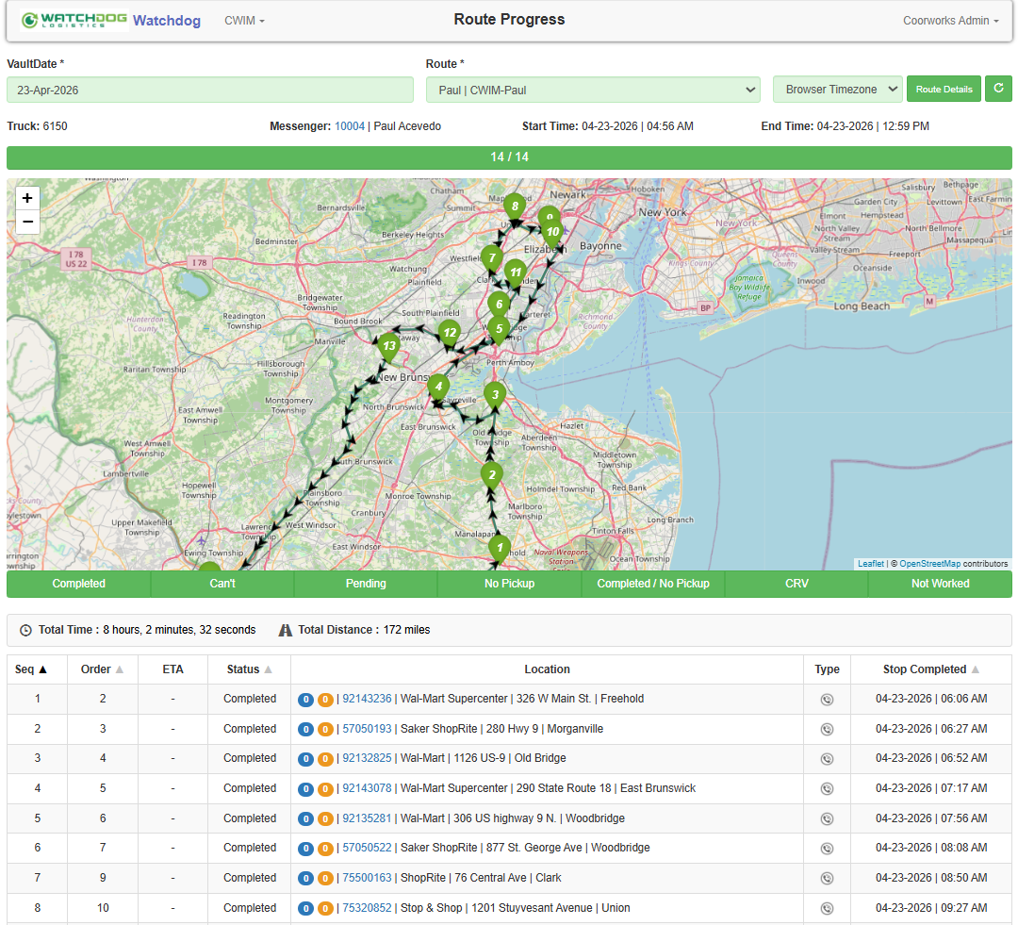

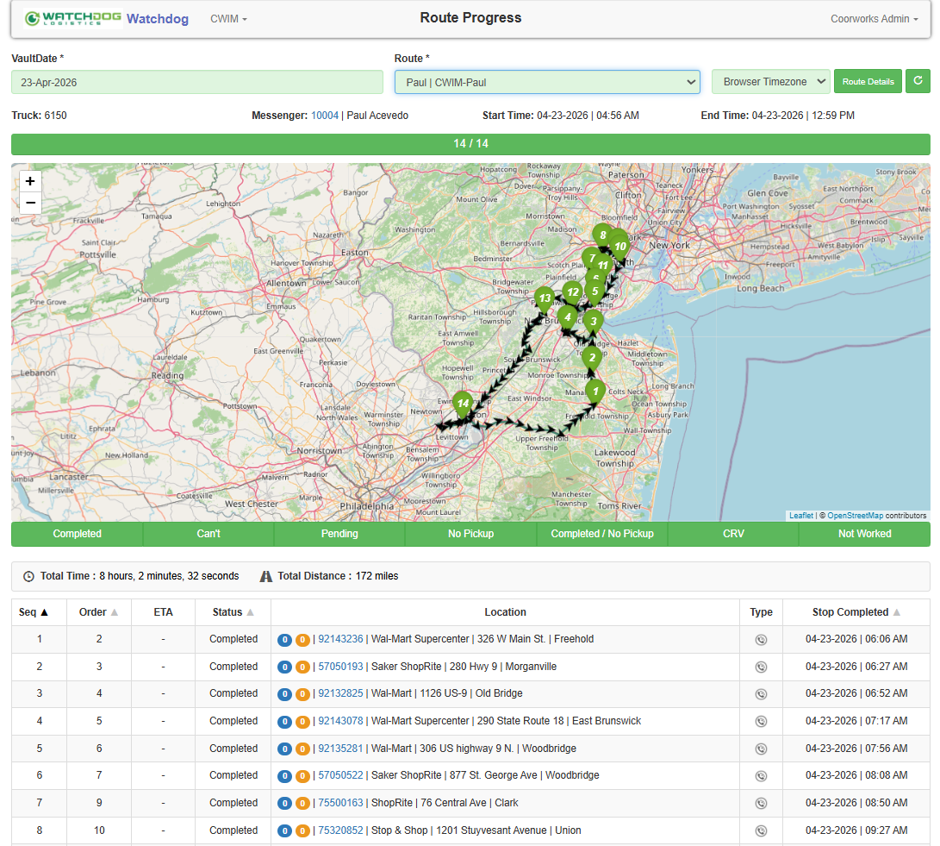

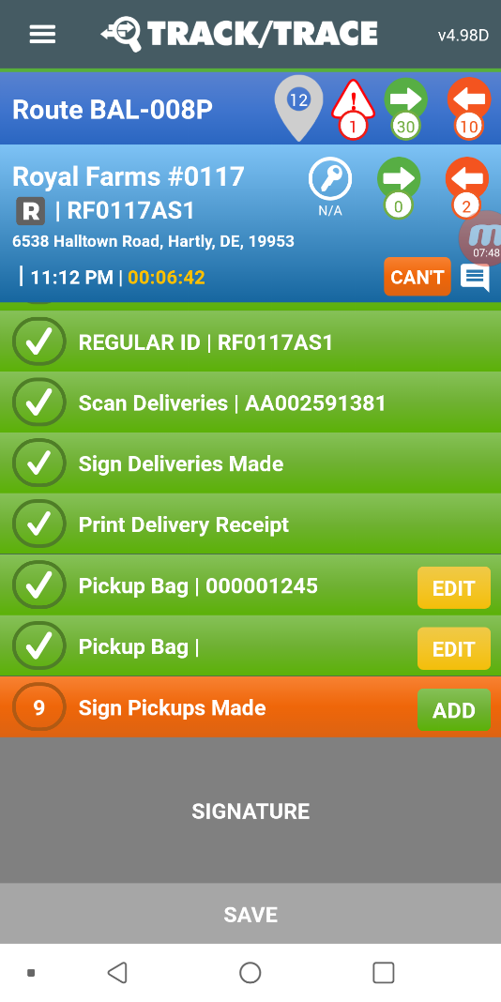


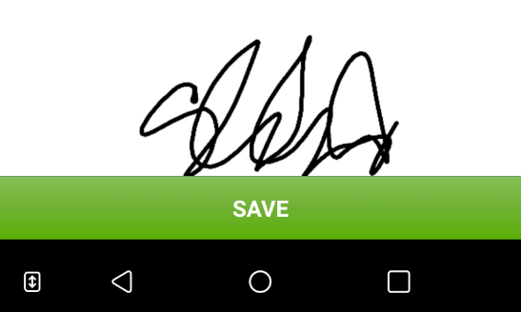
Breakthroughs Delivered
Company Optimization – CIT/ATM/FLM Cash Operations/Logistics
Main Branch
Go ->
Zero-Trust CIT/ATM/Vault/FLM Operations
$3Bn+/mo Secured Cash Processing/Transport
Challenge:
Replace a degrading cash logistics platform with a more adaptive, streamlined, and auditable operations foundation leveraging contemporary technologies for a 24x7 high-volume cash processing/transportation provider.
Target:
Provide a simplified, multi-lingual, multi-currency cash operations platform with centralized control enforcements across all aspects of the operations model (vaults, branches, trucks, routes, field users)
Outcome:
Reduced resource onboarding times, increased operating consistency, and centralized auditing of all operational details across billions in monthly cash movements.
Workflow Enforcement
Schedule Demo

Slide 9
Main Branch
Workflow Enforcement
{Source Image at Folder | CoorWorks Website v3 | TNT.jpg}

Slide 10
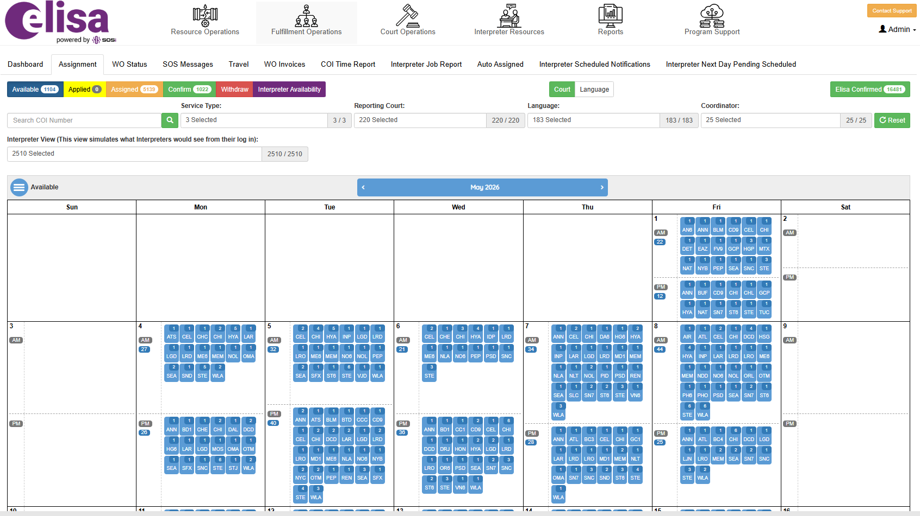
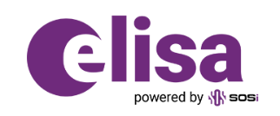
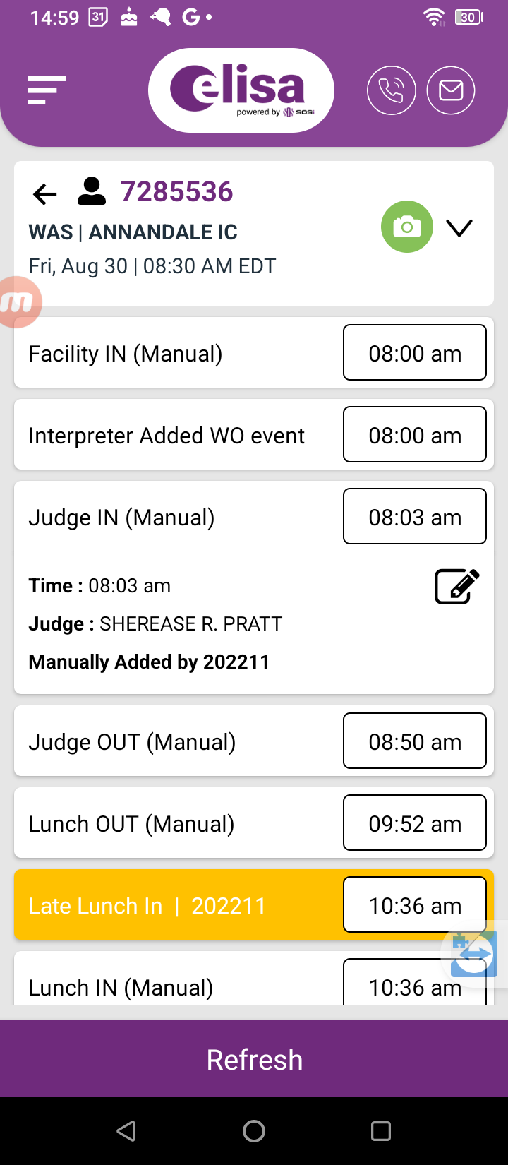
Breakthroughs Delivered
Program Optimization – Contracted Services Fulfillment + Compliance Mgmt
US Immigration Court Services
Contracted Interpreter Fulfillment +Compliance
25k+/mo DOJ/EOIR Interpretation Service Orders
Challenge:
Reduce resources/costs associated with manually coordinating court work order assignments with aligned contract resources, to increase contractor compliance with governmental work performance requirements, and to avoid government penalties for underdelivering minimum work order fulfillment rates.
Target:
Provide an uber-like open marketplace for DOJ approved court interpretation contractors to self-select appropriate case loads within defined operating rules and contractor rate preferences.
Outcome:
82%+ automated fulfillment of approximately 20-25k/month DOJ approved interpretation service work orders and massive reduction of internal processing requirements to invoice services.
Government Compliance

Slide 11
Government Compliance
{Source Image at Folder | CoorWorks Website v3 | ELISA.jpg}

Slide 12

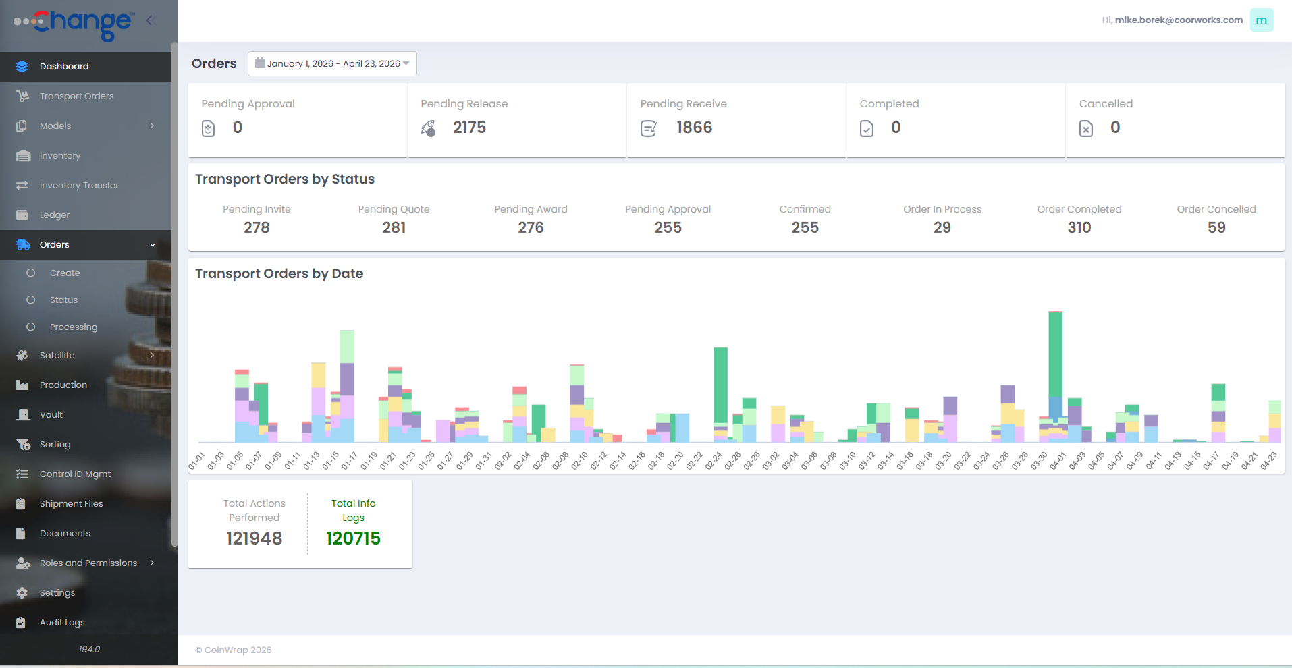
Breakthroughs Delivered
Business Optimization – Coin Currency Order Processing
Coin Currency Processing Management
$100M+/mo Coin Processing Order Flows
Challenge:
Digitally transform internal operations for national coin processing and servicing operation
Target:
Expedite coin packaging turns and increase overall business velocity
Outcome:
$100M+/mo in fully-auditable coin packaging orders, creation of new business line for transportation coordination, increased billing accuracy and speed
Revenue Velocity

Slide 13
Revenue Velocity
{Source Image at Folder | CoorWorks Website v3 | CHANGE.jpg}

Slide 14
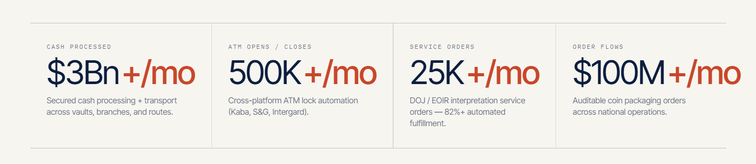
{Thin Performance Section Beneath Breakthroughs}

Slide 15
Approach | Multi-Dimensional Partnering
{would like for an auto scroll vertically of the 3 words and on display of each word hold it for 7-10 seconds while displaying the 3 bullet points for each word}
Adaptive
Budget
Timeframe
Every engagement is engineered against three simultaneous constraints: the budget you actually have, the timeframe the market will reward, and the goal that moves the operating metric. Nothing gets sacrificed — the approach is how.
Goal
{Display when Budget ON}
Engineered against the spend you have — not the retainer you’ve gotten pitched elsewhere.
Budget-Driven Solution Engineering
Agile Resourcing
Realistic AI Deployment
{Display when Timeframe ON}
Platform accelerations over bespoke builds — ship in quarters, not years.
Platform Accelerations
Iterative Functional Development
Direct Stakeholder Participation
{Display when Goal ON}
Outcome-aligned — the success condition is the operating metric, not the spec document.
Innovation Validation
Collaborative Outcome Targeting
Creative IP Arrangements

Slide 16

{Thin Summary Section Beneath Approach Section}

Slide 17
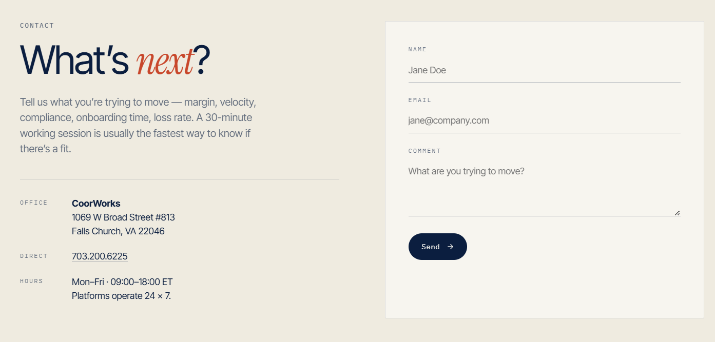
Support@Coorworks.com

Slide 18
{Previous Iterations Past This Point}

Slide 19
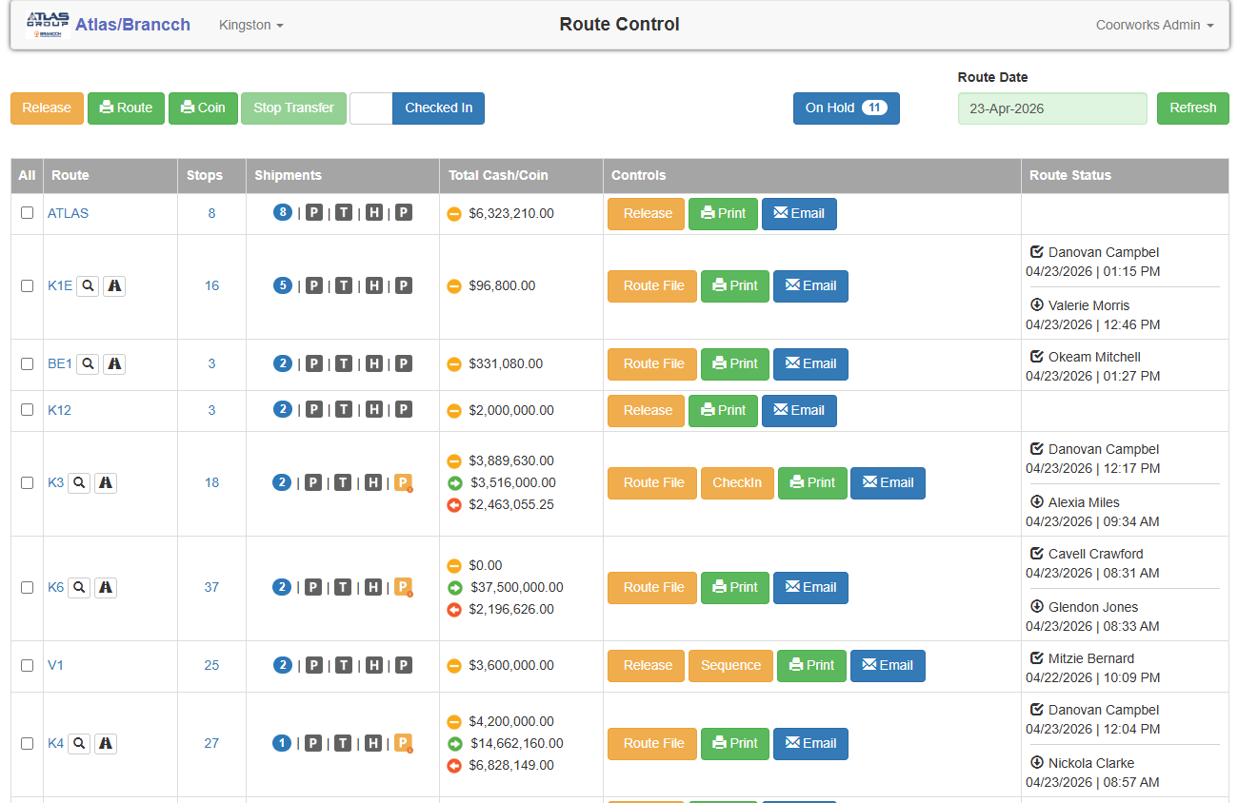
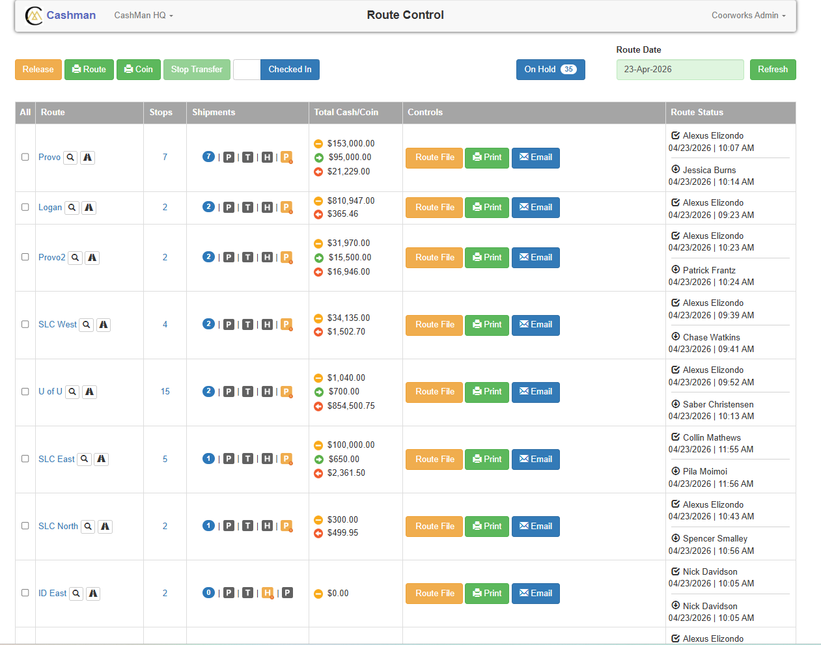
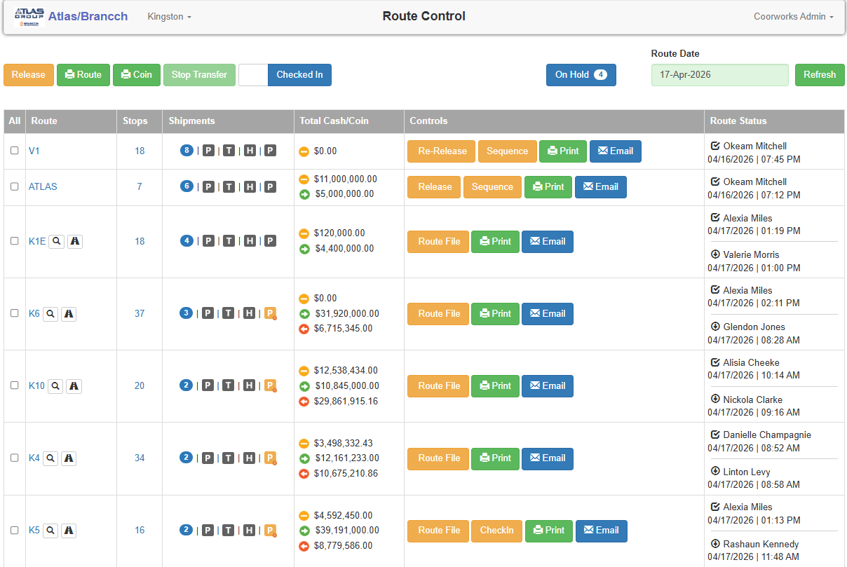
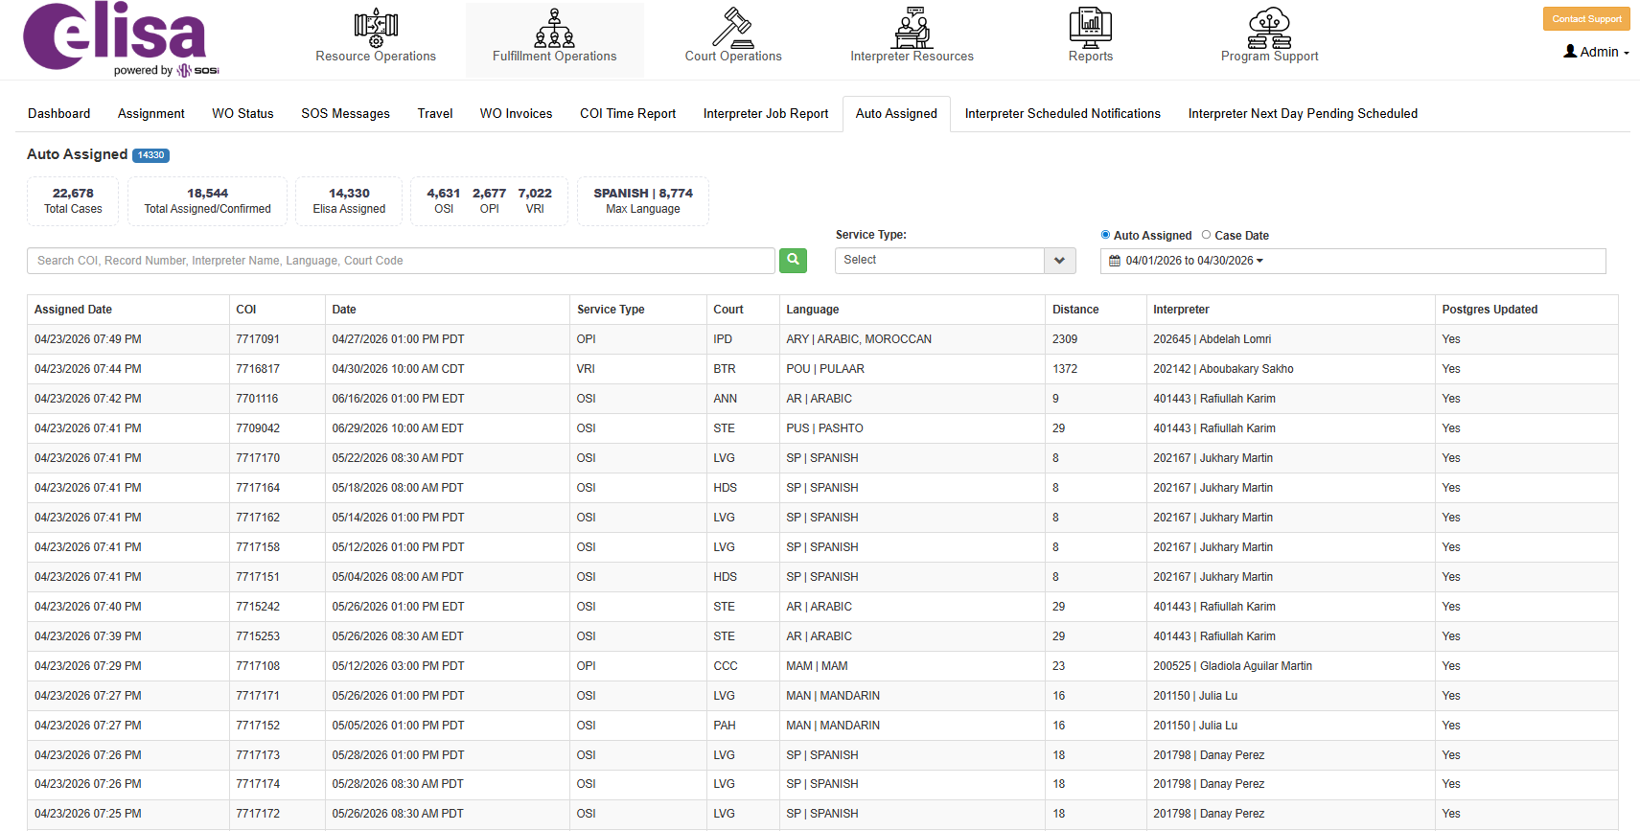
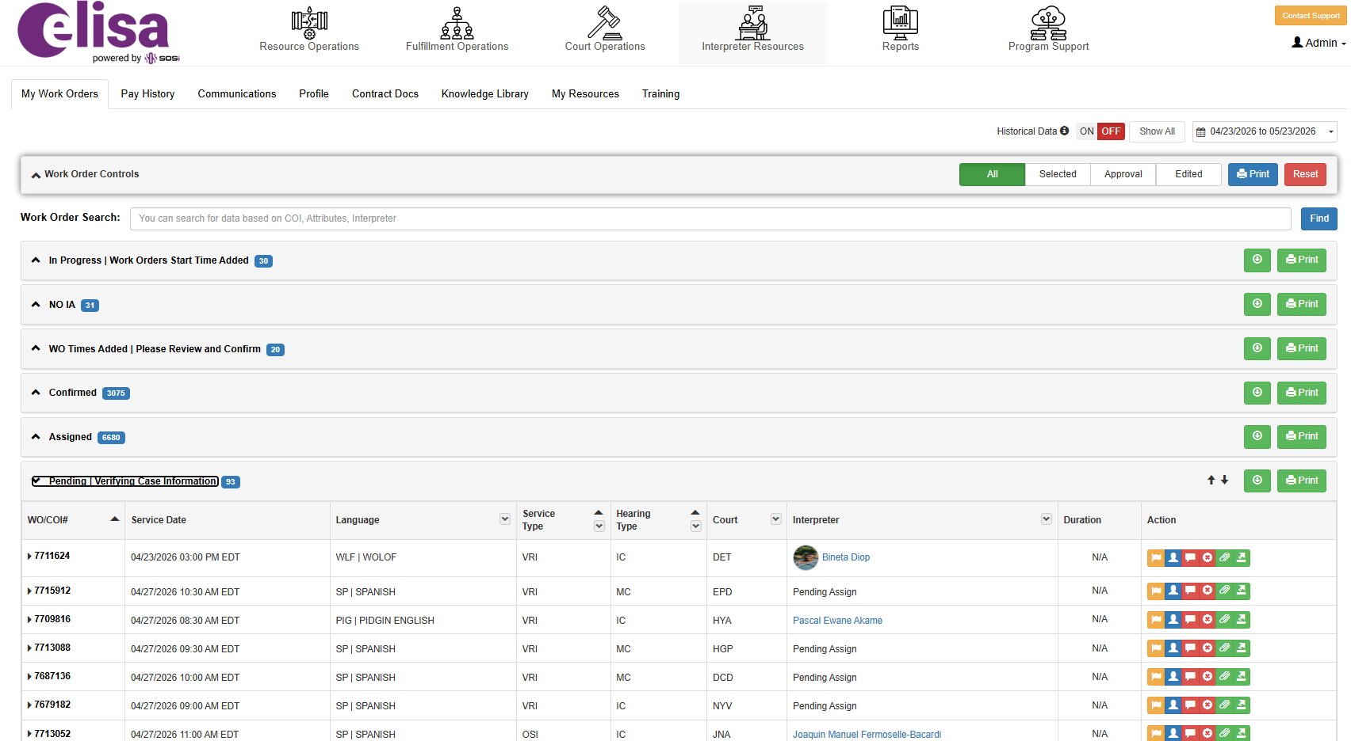
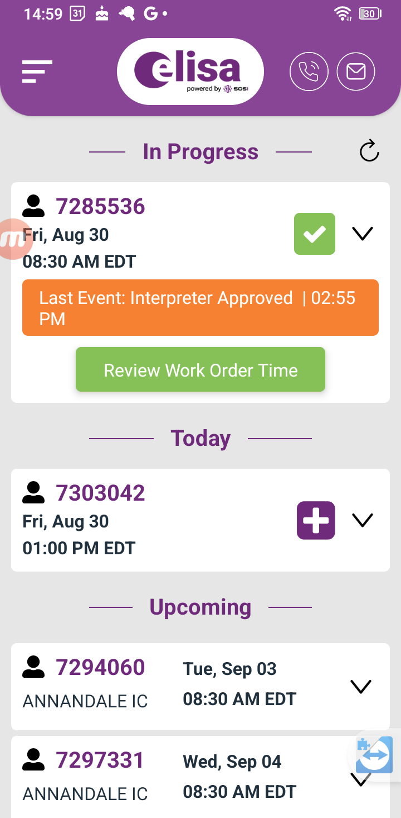
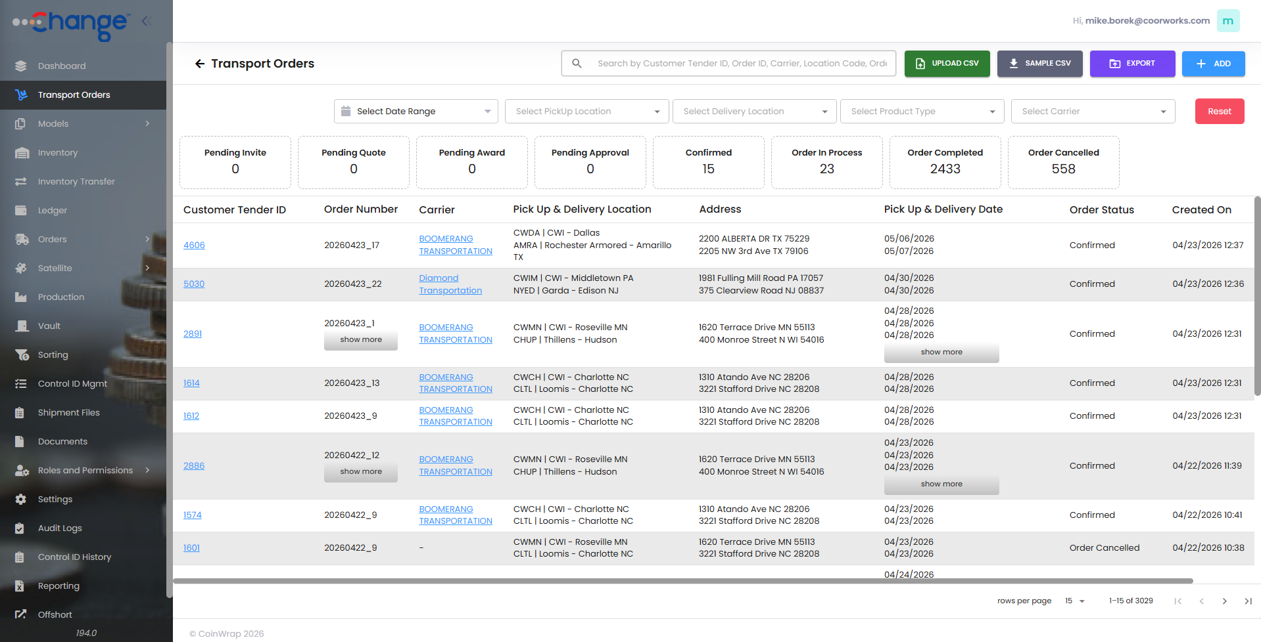
IMAGE COLLECTION (not for site layout – just storage)

Slide 20
Capabilities | Optimizations-as-a-Service
Zero-Trust Controls
Process Transformations
Event-Rule Models
Dynamic Configurations
Accountable Permissions/Procedures
Compliance Enforcements
Streamlinings
User Proofings
Functional Automations
Nuanced Workflows
Market/Service Expansions
Expectation Shapings
Loss Preventions
Customer Integrations
Value Rewirings
Market Steering Innovations
Systems Integrations
KPIs/Analytics

Slide 21
Capabilities | Optimizations-as-a-Service
Zero-Trust Controls
Process Transformations
Event-Rule Models
Dynamic Configurations
Accountable Permissions/Procedures
Compliance Enforcements
Streamlinings
User Proofings
Functional Automations
Nuanced Workflows
Customer Integrations
Loss Preventions
Expectation Innovations
Systems Integrations
KPIs/Analytics

Slide 22
Challenge:
Securely automate permitted ATM lock access requests directly from authorized field technicians and cash loaders
Target:
Reduce manpower requirements to staff dispatch support operations while preserving fully security and auditability
Outcome:
Cross-ATM-lock-system-platform offloading 95%+ of routine daily manual dispatching costs

Slide 23
Breakthroughs Delivered | Company Optimization – CIT/ATM/FLM Cash Operations/Logistics
Main Branch
Visit Site
Zero-Trust CIT/ATM/Vault/FLM Operations
$3Bn+/mo Secured Cash Processing/Transport
Schedule Demo
Workflow Enforcement

Slide 24
Challenge:
Replace a degrading cash logistics platform with a more adaptive, streamlined, and auditable operations foundation leveraging contemporary technologies for a 24x7 high-volume cash processing/transportation provider.
Target:
Provide a simplified, multi-lingual, multi-currency cash operations platform with centralized control enforcements across all aspects of the operations model (vaults, branches, trucks, routes, field users)
Outcome:
Reduced resource onboarding times, increased operating consistency, and centralized auditing of all operational details across billions in monthly cash movements.

Slide 25
Breakthroughs Delivered | Program Optimization – Contracted Services Fulfillment + Compliance Mgmt
US Immigration Court Services
Contracted Interpreter Fulfillment +Compliance
25k+/mo DOJ/EOIR Interpretation Service Orders
Government Compliance

Slide 26
Challenge:
Reduce resources/costs associated with manually coordinating court work order assignments with aligned contract resources, to increase contractor compliance with governmental work performance requirements, and to avoid government penalties for underdelivering minimum work order fulfillment rates.
Target:
Provide an uber-like open marketplace for DOJ approved court interpretation contractors to self-select appropriate case loads within defined operating rules and contractor rate preferences.
Outcome:
82%+ automated fulfillment of approximately 20-25k/month DOJ approved interpretation service work orders and massive reduction of internal processing requirements to invoice services.

Slide 27
Breakthroughs Delivered | Business Optimization – Coin Currency Order Processing
Coin Currency Processing Management
$100M+/mo Coin Processing Order Flows
Revenue Velocity

Slide 28
Challenge:
Digitally transform internal operations for national coin processing and servicing operation
Target:
Expedite coin packaging turns and increase overall business velocity
Outcome:
$100M+/mo in fully-auditable coin packaging orders, creation of new business line for transportation coordination, increased billing accuracy and speed

Slide 29
Contact
What’s Next?
Tell us what you're trying to move — margin, velocity, compliance, onboarding time, loss rate. A 30-minute working session is usually the fastest way to know if there's a fit.
CoorWorks
1069 W Broad Street #813
Falls Church, VA 22046
703-200-6225
Name
Support@Coorworks.com
Email
Comment

